Slide 1
Style Transfer for Videos

Slide 2
Style Transfer for Videos 1. Intro - keywords

Slide 3
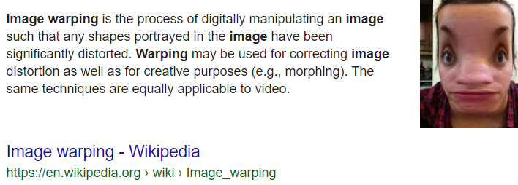
Keywords for ‘style transfer’ – 1. warping

Slide 4
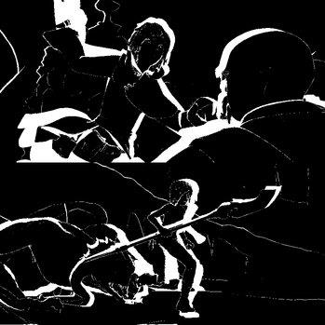
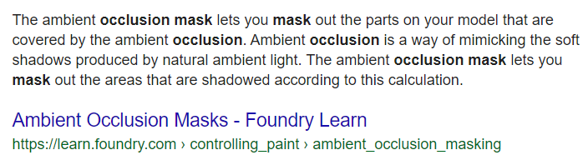
Keywords for ‘style transfer’ – 2. occlusion mask

Slide 5
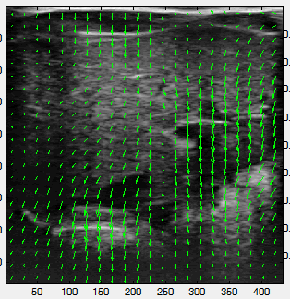
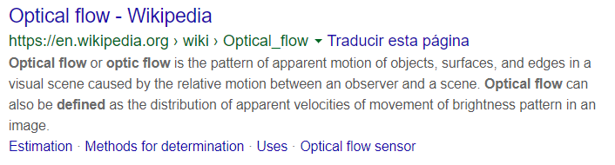
Keywords for ‘style transfer’ – 3. Optical flow

Slide 6
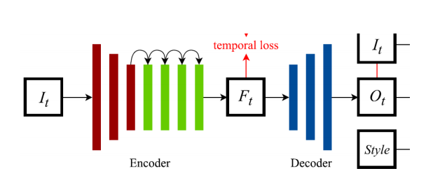
Keywords for ‘style transfer’ - 4. Encoder and Decoder

Slide 7
Style Transfer for Videos 2. (Old) Papers

Slide 8
읽었던 논문들(체감 4개 by 예은 Et al.)
Ruder
Et . al
ReCoNet

Slide 9
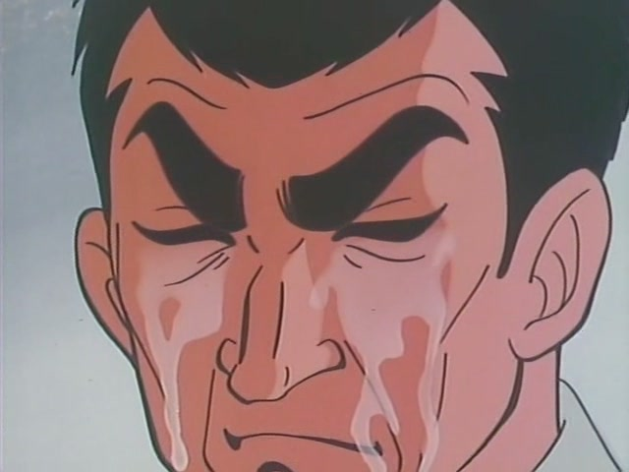
읽었던 논문들
Ruder
Et . al
ReCoNet

Slide 10
Ruder Et.al
Ruder
Et . al
타이탄으로 돌려도 5분 이내 영상에
10시간이 넘는다

Slide 11
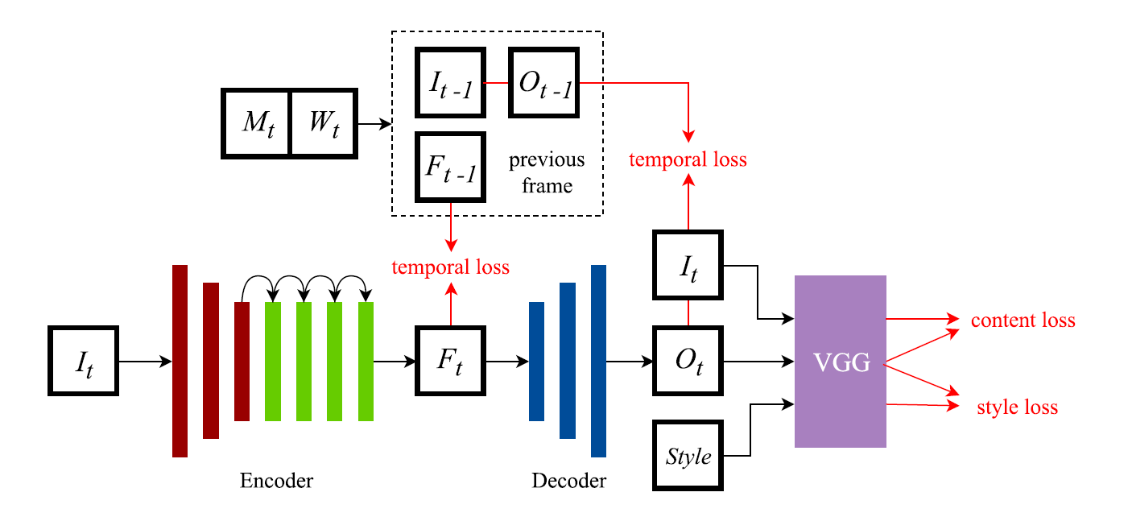
ReCoNet
ReCoNet
Optical Flow
Occlusion Mask

Slide 12
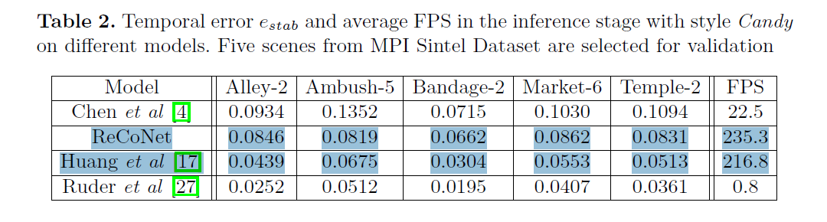
ReCoNet
ReCoNet

Slide 13
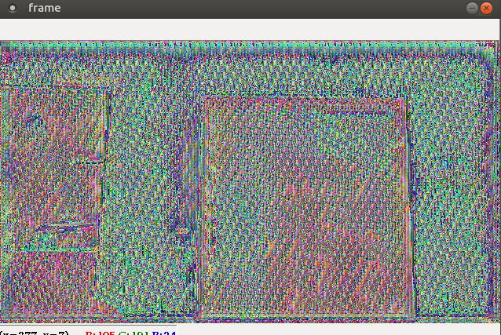
ReCoNet

Slide 14
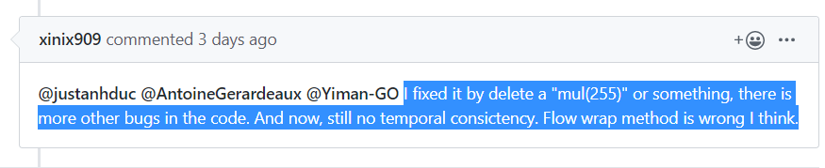
ReCoNet

Slide 15
안되겠다.

Slide 16
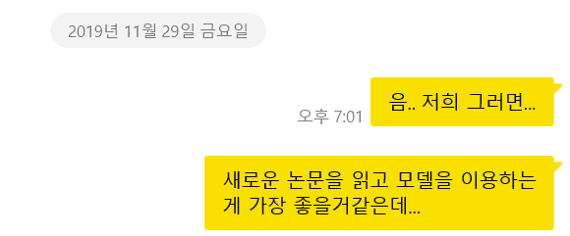
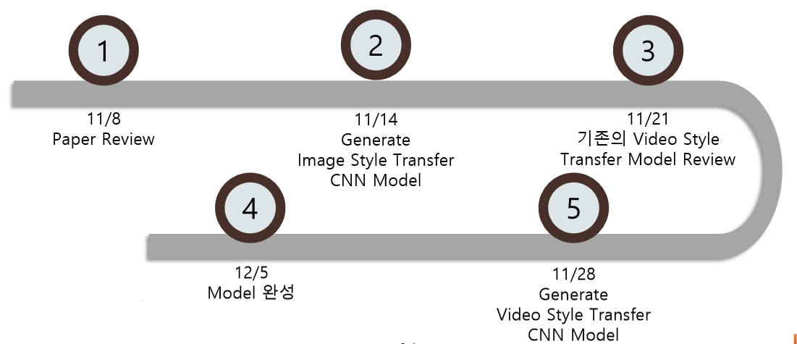


Slide 17
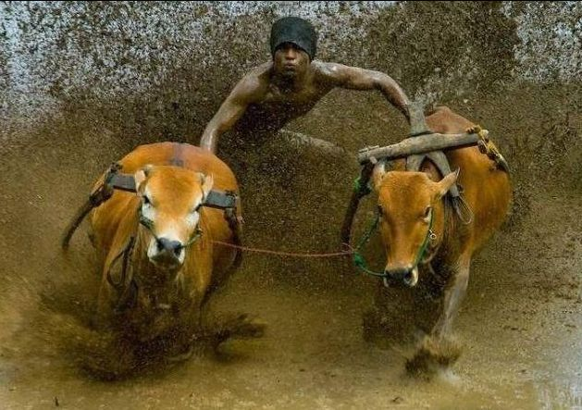

Slide 18
Style Transfer for Videos 3. “NEW” Paper!!

Slide 19
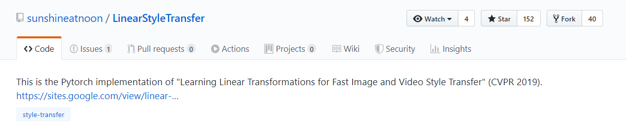
Linear Style Transfer

Slide 20
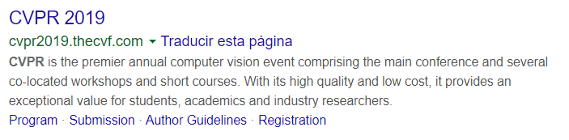
CVPR 2019 paper

Slide 21
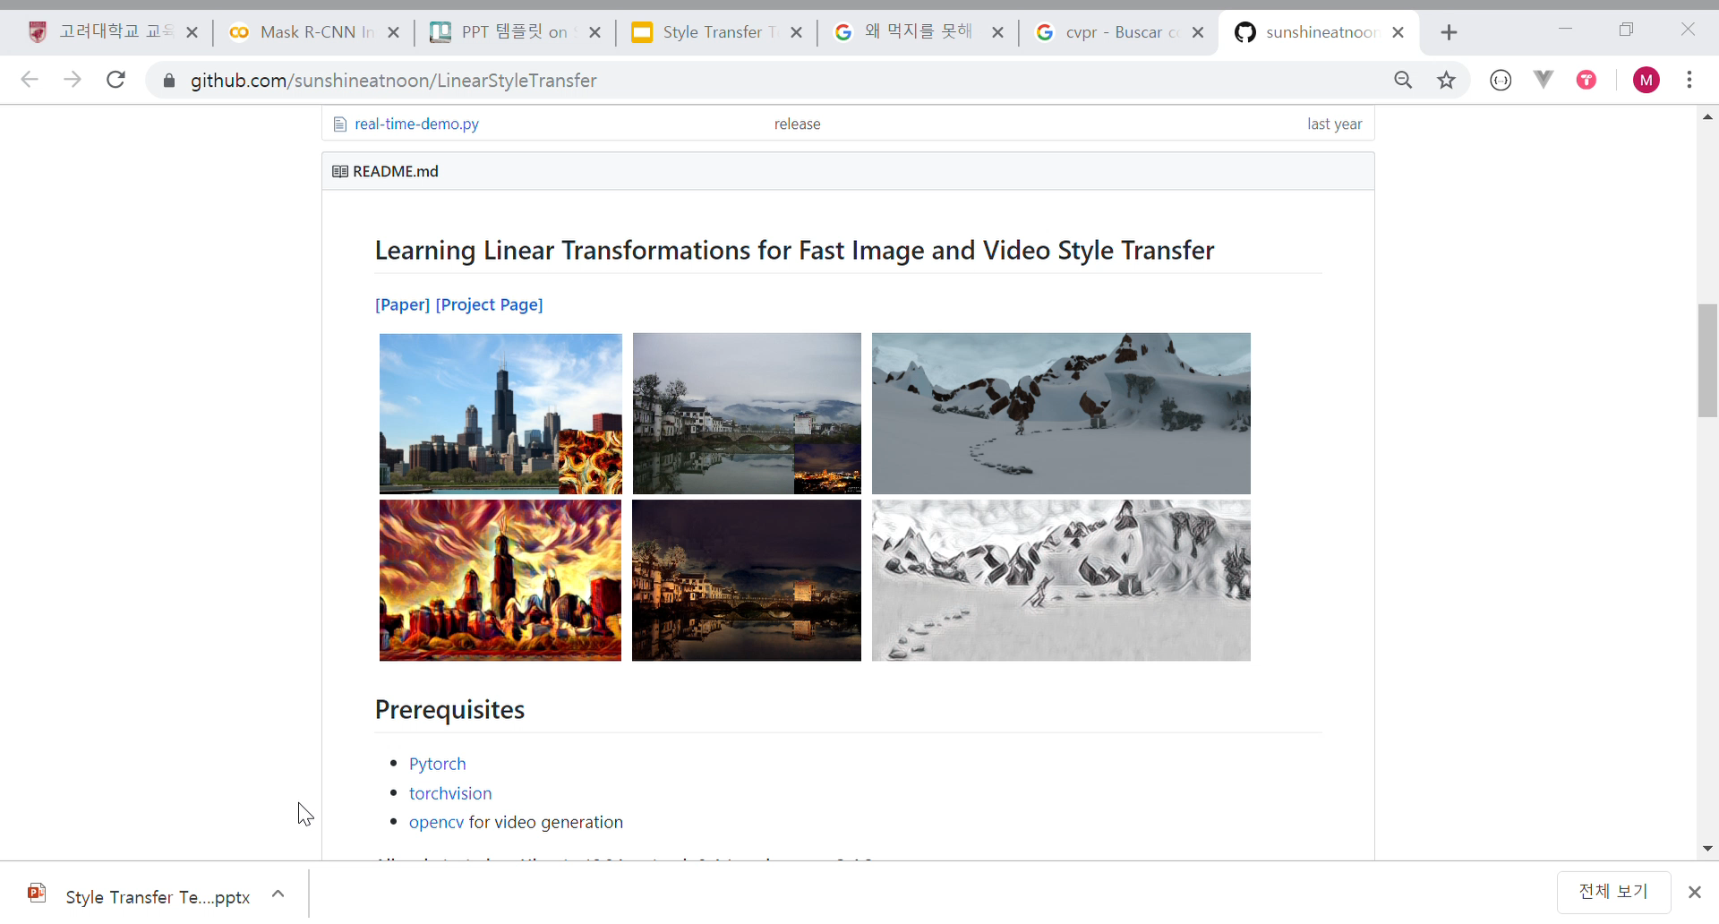
Sample results of this model

Slide 22
『Learning Linear Transformations for Fast Image and Video Style Transfer』

Slide 23
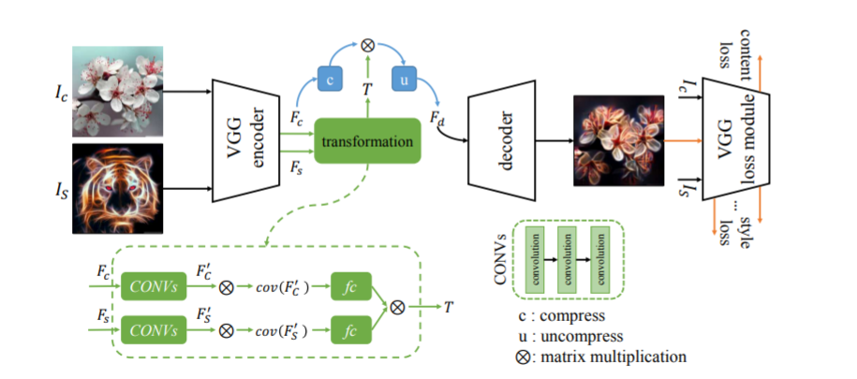
Learning Linear Transformations for Fast Image and Video Style Transfer

Slide 24
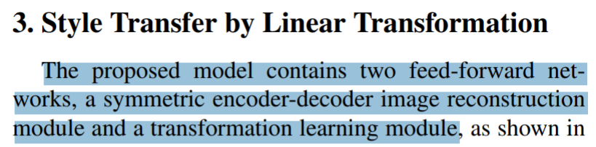
Learning Linear Transformations for Fast Image and Video Style Transfer

Slide 25
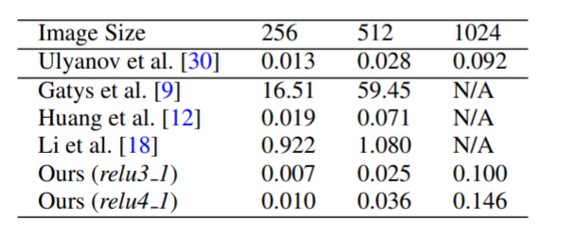
Runtime Performance

Slide 26
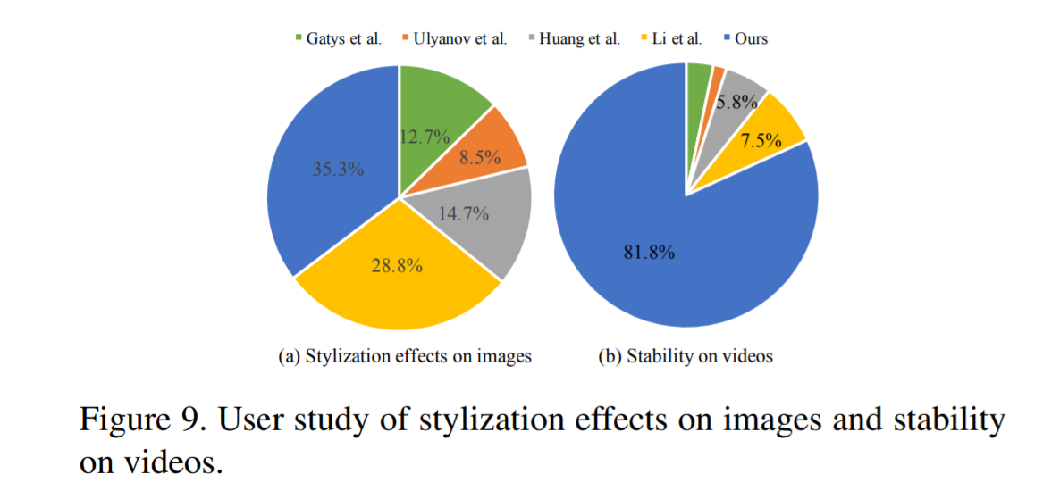
Runtime Performance

Slide 27
Style Transfer for Videos 4. Results

Slide 28
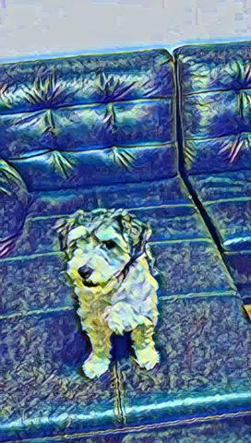
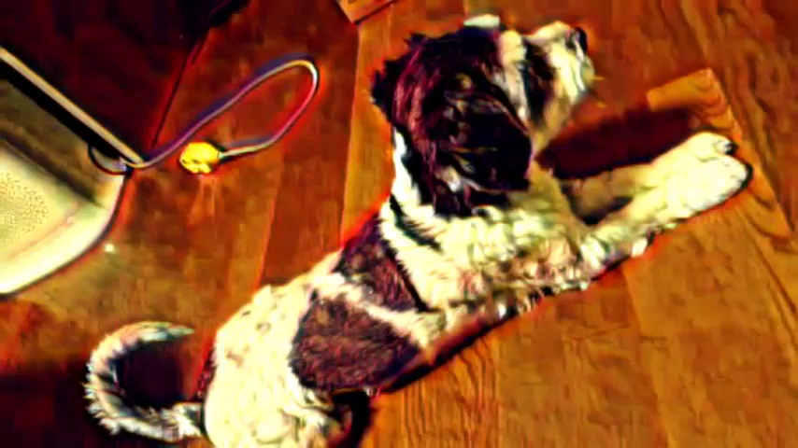
Our result for sample video – 예은’s cutie dog (30secs for 2 mins)

Slide 29

All plans are made

Slide 30

감사합니다!!
한학기 동안 모두 수고하셨습니다!

Slide 31
